Slide 1
Customer Retention Case Study
E-retail factors for customer activation and retention: A case study from Indian e-commerce customers.

Slide 2
Problem Statement and Understanding
Customer satisfaction has emerged as one of the most important factors that guarantee the success of online store; it has been posited as a key stimulant of purchase, repurchase intentions and customer loyalty. A comprehensive review of the literature, theories and models have been carried out to propose the models for customer activation and customer retention. Five major factors that contributed to the success of an e-commerce store have been identified as: service quality, system quality, information quality, trust and net benefit. The research furthermore investigated the factors that influence the online customers repeat purchase intention. The combination of both utilitarian value and hedonistic values are needed to affect the repeat purchase intention (loyalty) positively. The data is collected from the Indian online shoppers. Results indicate the e-retail success factors, which are very much critical for customer satisfaction.

Slide 3
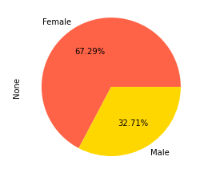
EDA Steps and Visualizations
Finding patterns of data through visualization and reveal the hidden trends from data.
Using both matplotlib and seaborn library to visualize the data.
Finding relationships between features using line graphs, stripplots and heatmap.

Slide 4
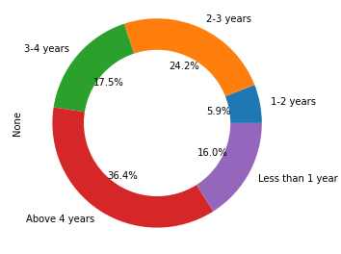
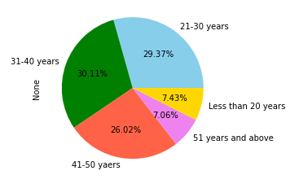
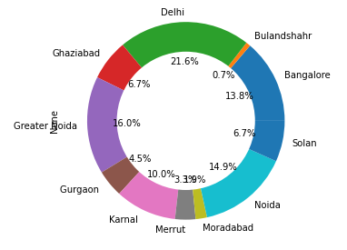
Visualization

Slide 5
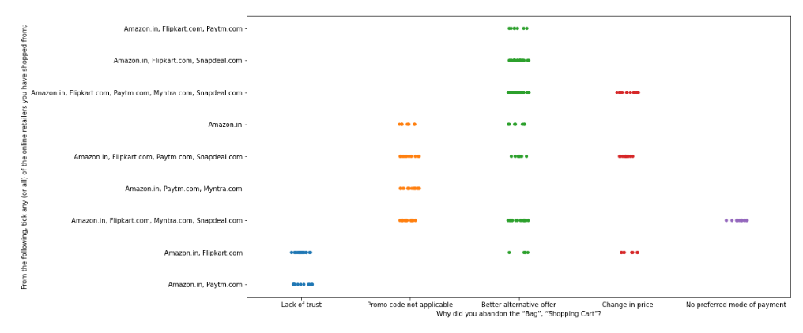
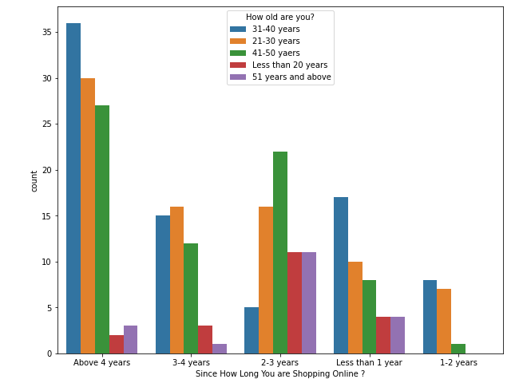
Visualization

Slide 6
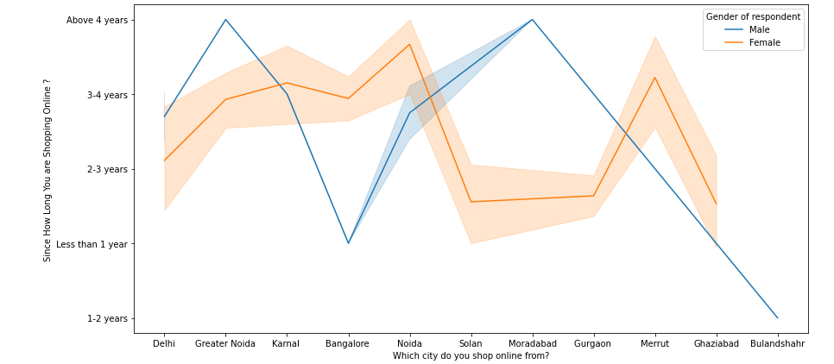
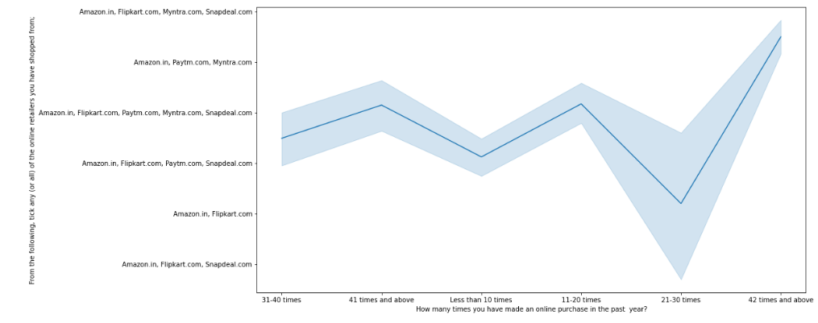
Visualization

Slide 7
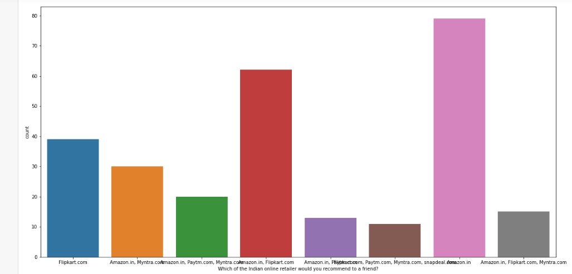
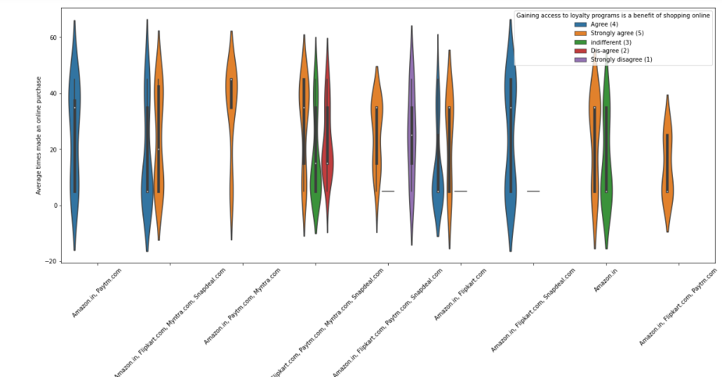
Visualization

Slide 8
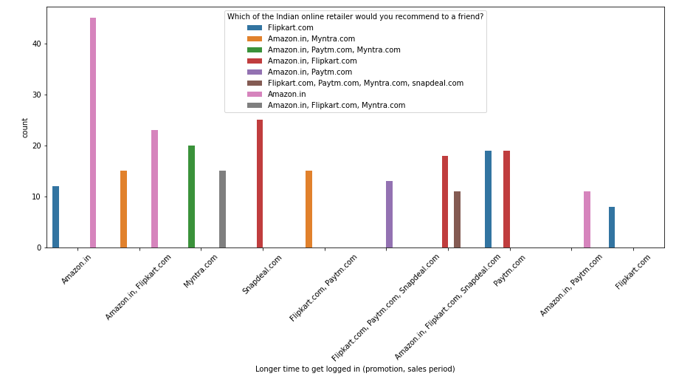
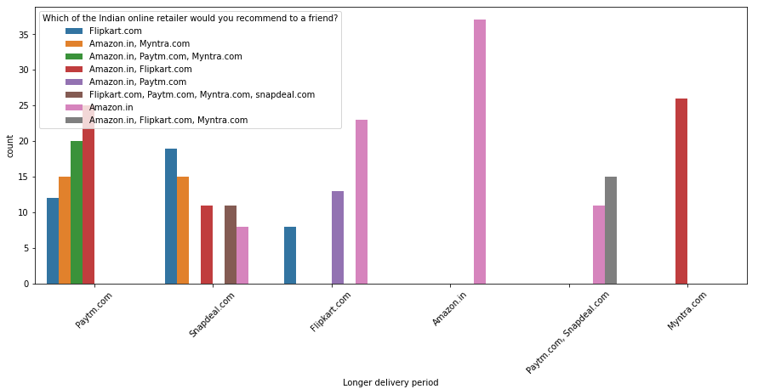
Visualization

Slide 9
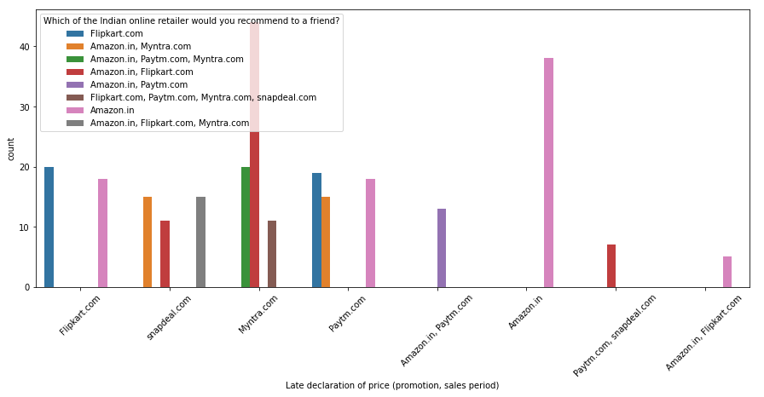
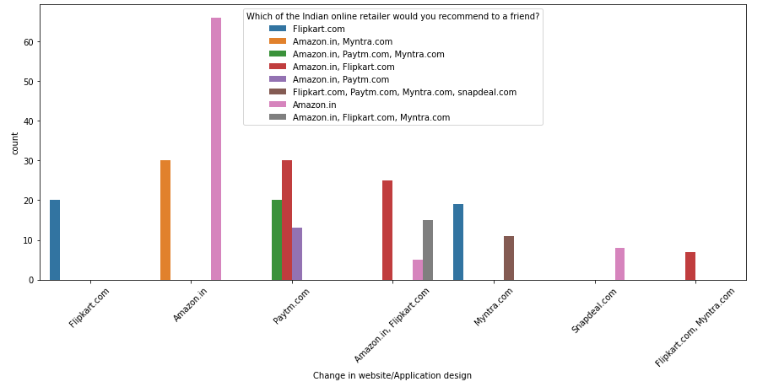
Visualization

Slide 10
Steps, Assumptions and Analysis:
The dataset contains no null values no need to clean the data. We can see this using heatmap.
Here we have assumed and converted the number of times purchased to an average times purchased using dictionary.
As we have analysed some of the personal data of the customers and the observation is as follows:
Most of the participants in this survey are females, almost more than double that of male.
The people belonging to age group 31-40 years are more when compare to other age groups followed by 21-30 years. And 51 years and above are the least ones.
Most people who shop online are from Delhi followed by Noida and Bengaluru ranked the next in the list.
People who are shopping for more than 4 years are highest in rate.
Majority of people shop online only 10 times a year and who buys 42 times and more than that are very less in number.

Slide 11
Analysis
We can clearly see from the graphs that most of time people abandon the bag is because they get a better alternative offer. There is a lack of trust seen in amazon, flipkart and paytm by some people.
Most of the people shopping above four years are belong to the age group 31-40 and least of them belong to less than 20 years followed by 51 years and above. People shopping for one to two year are belongs to the age group 21 to 50 years. Less than 20 years and 51 years and above are excluded from this.
Most of the males who are shopping for more than 4 years are from Greater Noida city.
The density of shopping male is highest in Noida and Solan.
The males from Bangalore and Bulandshahr are purchasing for less than one year.
The density of females is more than that of male. However highest shopping females are found in the cities like Delhi, Karnal and Solan.
The females who are shopping for 3 to 4 years are belong to Noida and Merrut cities.
The People who purchase almost 31 to 40 times are loyal to the service or that online portal and those who are buying 21 to 30 years disagree this.

Slide 12
Analysis
Heavy shoppers who shop more than 41 times a year shop from all the online brands, some of the people who shop from 32-40 and less than 10 times a year seem to exclude myntra. People shop from Amazon and flipkart whatever be the cases.
Here we have converted the number of times purchased to an average times purchased using dictionary.
People who are shopping from amazon and paytm are most loyal. Flipkart and snapdeal also have this but people who shop almost everywhere disagree with this point.
So seeing the last graph we can see that most of the customers use to recommend Amazon and flipkart followed by myntra and paytm to their friend.

Slide 13
Conclusion
The results of this study suggest the following outputs which might be useful for E-commerce websites to extend their business.
The cost product, the reliability of the E-commerce company and the return policies all play an equally important role in deciding the buying behaviour of online customers. The cost is an important factor as it was the basic criteria used by online retailers to attract customers. The return policies are important because in all retail customer does not get to feel the product. Thus, he/she wants to be sure that it will be possible to return the product if he/she does not like it in real.
All the websites are not equally preferred by online customers. Amazon was the most preferred followed by Flipkart. This can be explained easily by previous result that we got. These two companies are most trusted in the industry and hence, have a huge reliability. Also, these websites have the most lenient return policies as compared to others and also the time required to process a return is low for these.

Slide 14


